Slide 1

Environmental Analysis of Air Pollutants to indicate air quality
By: Team 5
(Belal Akram, Mahmoud Ashraf, Rasha Metwally)

Slide 2

Agenda
1
Environmental Field
2
Types of Environmental Pollution
3
Air Pollution
4
Analyzing Air Pollution Data
5
Common KPIs for Analysis
6
Project Data Overview
9

Slide 3

Environmental Field
Study of surroundings affecting life (air, water, soil)
Sustainable balance between human activities and ecosystems

Slide 4
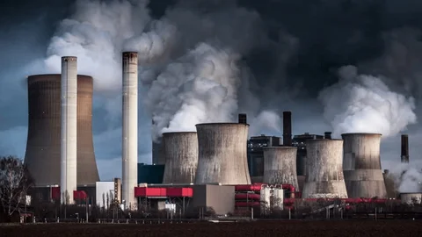
Types of Environmental Pollution
Air Pollution
Water Pollution
Soil Pollution
Noise Pollution
Thermal Pollution
Light Pollution
Radioactive Pollution
Plastic Pollution

Slide 5

Pollutant | Sources
Carbon Monoxide (CO) | Incomplete combustion of fossil fuels, vehicle exhaust, wildfires
Sulfur Dioxide (SO₂) | Coal and oil burning in power plants, industrial processes, volcanic eruptions
Nitrogen Oxides (NOₓ) | Vehicle emissions, power plants, industrial facilities, lightning
Particulate Matter (PM₁₀) | Construction activities, road dust, industrial emissions, natural dust storms
Particulate Matter (PM₂.₅) | Vehicle emissions, combustion processes, wildfires, chemical reactions in the atmosphere
Air Pollution
Release of harmful substances (gases, particulates)
due to human activities

Slide 6

Analyzing Air Pollution Data
Data Collection
1
2
Data Cleaning
Data Aggregation
3
4
Statistical
Analysis
Visualization
5
6
Comparison
with Standards
Identify Sources and Trends
7
8
Report Findings

Slide 7

Common KPIs for Air Pollution Analysis
Pollutant Concentration Levels
Population Exposure
Exceedance Days
Health Impact Metrics
Pollution Sources Contribution
Emission Reduction Progress
Temporal Trends
Meteorological Influences
Spatial Distribution
Air Quality Index (AQI)

Slide 8
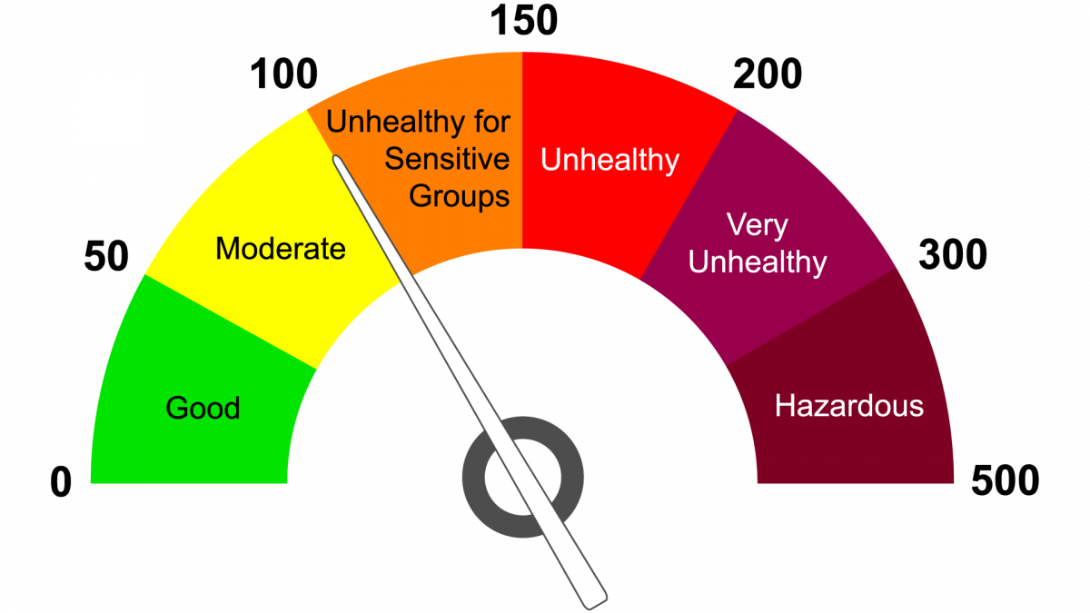
Air Quality Index (AQI)
AQI Range
Air Pollution Level
Health Implications
0 - 50
Good
Little or no risk
51 - 100
Moderate
Acceptable, minor concerns for sensitive individuals
101 - 150
Unhealthy for Sensitive Groups
Health effects for sensitive individuals
151 - 200
Unhealthy
General public may experience health effects
201 - 300
Very Unhealthy
Health warnings for the entire population
300+
Hazardous
Serious health effects for everyone

Slide 9

Project Data Overview
Source: Central Pollution Control Board (CPCB)
Structure: 7 Columns, 438 Rows
Key Pollutants: SO₂, NO₂, PM10, PM2.5
Data Quality Issues: Missing values, mixed data types, inconsistent columns

Slide 10


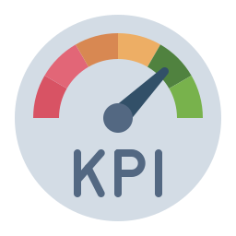


Proposed Steps and Visualization Tools
Data Cleaning
Key Performance Indicators
Visualization tools

Slide 11

Dividing Roles for AQI Analysis Project
Collaborative analysis of AQI data over multiple years. Goal: prepare a unified Power BI dashboard and actionable insights.

Slide 12
Step 1: Data Preparation
Tasks
Assigned Members
Merge data for other 4 years
Member 1: Collect, merge datasets, add the Year column
Clean and validate data
Metadata preparation
Member 2: Rename columns, handle missing values, ensure consistency
Member 3: Validate dataset, prepare metadata

Slide 13
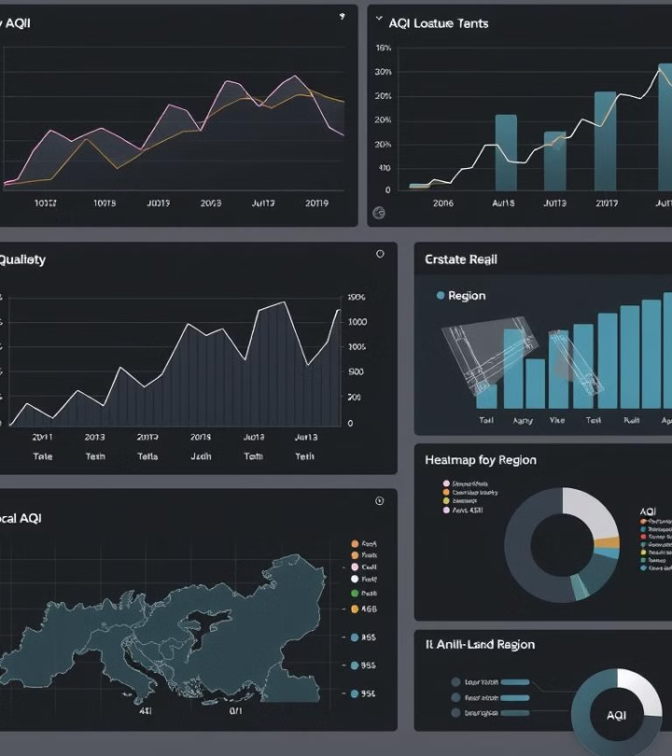




Step 3: Visualization
Line Charts
Heatmaps
Trends and progressions
Spatial patterns and hotspots
Bar Charts
Pie Charts
Comparative analysis
Proportional breakdown

Slide 14

Steps 4 & 5: Insights and Collaboration
Summarize Findings
Identify Top/Bottom Rankings
YoY trends, seasonal patterns, regional disparities
Cities with the worst AQI, states with the best AQI
Provide Recommendations
Solutions for improving AQI, mitigating pollution

Slide 15


